Slide 1

Academic Success Workshop
Getting Back on Track :
Click through the slides to progress through the workshop. Have your worksheet handy.

Slide 2
Academic Success Workshop
Welcome to our online workshop on Academic Success. This workshop is designed to assist students who are on academic warning or probation to get back on track with their academic journey.

Slide 3

Striving for success
We recognize that:
  every student intends to achieve their goals when they enter the college environment.
  Unexpected roadblocks often impede success.
The goal of this workshop is to help:
  Identify your strengths
  Identify barriers
  Prepare you to meet with a Counseling Center advisor and develop a success action plan.

Slide 4
Knowledge is Power:
Being a successful student means:
Having a sense of what it is that you seek to accomplish through your college education;
having defined career goals;
knowing what motivates you;
knowing your strengths, and
understanding how external factors can impact your academic achievement.
.

Slide 5
Motivation:
Let’s consider what brought you to the college in the first place:
  Why did you choose to go to college?
  Was TRCC your first choice?
  What are your academic goals?
  What are your career goals?
  What do you want to achieve?
  Do you think you are in the right degree program to achieve these goals?
  Undecided? It’s okay! Discuss this with an advisor: we have resources.
Reflecting on these questions can help you pinpoint your motivation and attitudes towards being at the college. These can impact your success. Please note your responses in the appropriate section of your Student Success Worksheet.

Slide 6
MOTIVATION:
The idea of changing one’s way of doing things to facilitate success can bring up feelings of anxiety and frustration. Thinking about you current situation, how ready do you feel to make changes).
1 2 3 4 5 6 7 8 9 10
No, I am not I am starting to I know I need I have been planning I am ready to
ready and/o r think about it. to do something how I will make some do it today
not feel that different. changes
I need to change
anything.
Enter the number of your readiness level on your worksheet.

Slide 7


Reflecting on Your Strengths:
The strengths and skills that you already have are the foundation for your success. Take a moment to consider the following:
  What are you really good at?
  What positive things do others say about you?
  Think of a past achievement, can you identify what key steps you took to be successful?

Slide 8
Building on Strengths:
  Please note your responses in the appropriate area on the worksheet.
  In your meeting with an advisor we will discuss how to apply these strengths to your academic journey.

Slide 9

Roadblocks to overcome:
Despite one’s best intentions many events and issues can derail a student from achieving their academic goals.
Understanding what factors have led to your current situation is key to getting back on track and in control of your educational journey.
Using your worksheet as a guide you can pinpoint some of the specific factors that have led to your situation.
The worksheet breaks down common obstacles into categories. Take a moment and complete the checklist.

Slide 10
Identifying Roadblocks:
After completing the checklist, identify what patterns you see.
You may find that your roadblocks fall across multiple categories or that they are contained within one area.
When you meet with your advisor, you will discuss and select key strategies related to overcoming these barriers. These will become part of your action plan.

Slide 11
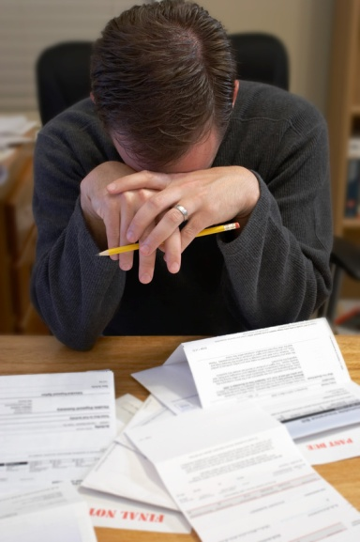

Knowledge is Power!
Reflecting on the roadblocks that you have identified:
  What items do you have control over?
  What items are beyond your control?
  What causes you to feel overwhelmed or discouraged?
  Please note your responses in the appropriate area
  on your worksheet.

Slide 12

Academic Habits:
Successful students develop:
  Time Management Strategies
  Test Taking Skills
  Good Study Habits
Successful students utilize:
  Support Groups
  Use available Resources
Please take a moment and complete the categories on the worksheet in these areas.

Slide 13
Back on Track: Success Strategies
Thinking about:
  your strengths,
  roadblocks that you have encountered,
  what is in your power to control;
  complete the checklist on the last page of the worksheet.

Slide 14

Back on Track: academic Standing
Now that you have reflected on key factors for ensuring academic success, take a moment to calculate the “hard” numbers that you will need to achieve to get to good standing.
A neat tool to help you determine what grades you need to achieve is an online GPA calculator. You can use the one on the resource list on the Academic Success Website. http://www.back2college.com/raisegpa.htm
Now complete the final section of your worksheet.

Slide 15
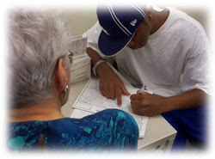
NEXT steps:
Call the Counseling and Advising Center to set up an appointment: 860-383-5217
OR
Drop in at the Counseling and Advising Center Wednesday (until 6:30 p.m.) or Thursday (until 4:30 p.m.)
The Success Action Plan that you develop with your advisor will get you back on track.

Slide 16

Best of Luck from TRCC Counseling and Advising Center

